Slide 1

ML Models
on Flower
Dataset

Slide 2
About The DATASET
The dataset used in this project consists of 3,670 flower images, categorized into five distinct classes: Daisy, Dandelion, Roses, Sunflowers, and Tulips. Each class represents one type of flower, and the images within each category contain various samples showing different colours, shapes, and lighting conditions.
The dataset provides a diverse collection of flower images that can be used for training and testing image classification models. This variety helps the model learn to recognize the unique visual features of each flower type, such as petal structure, color patterns, and overall shape. The dataset is well-suited for machine learning and deep learning tasks in computer vision that perform flower recognition and classification.

Slide 3
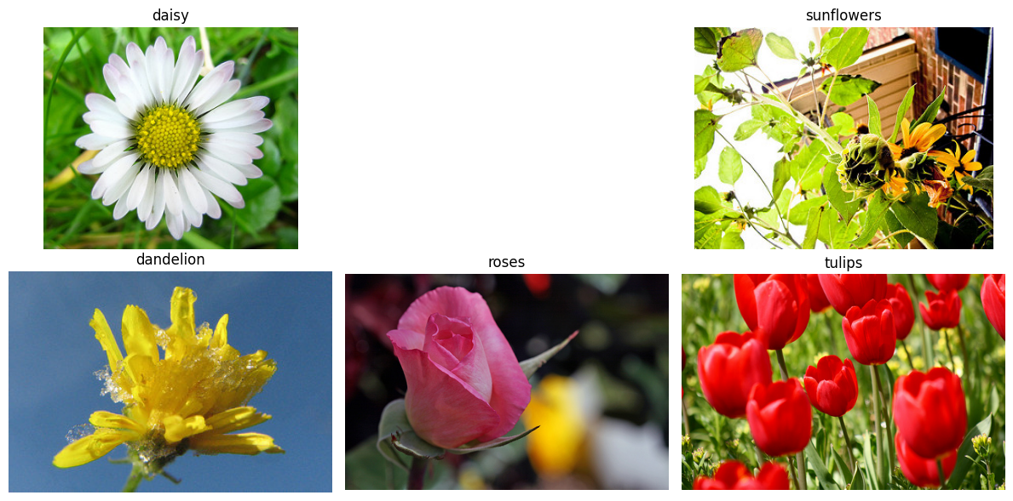
Samples of data

Slide 4

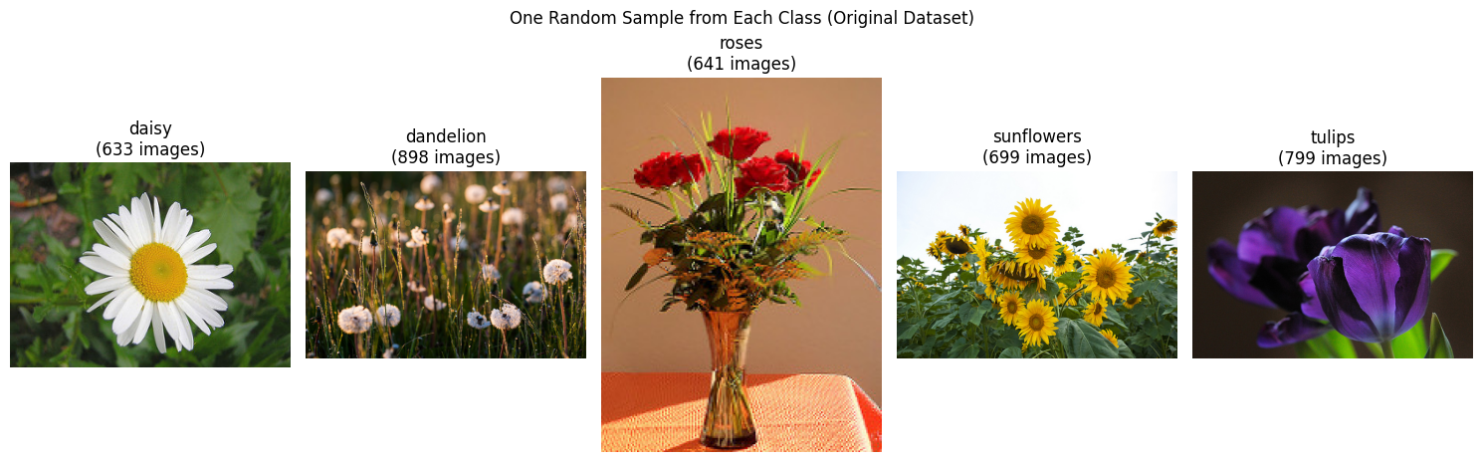
One random image form Each Class
Daisy
633 images
Dandelions
898 images
roses
691 images
Sunflower
699 imagses
Tulip
799 images

Slide 5
Loading the dataset

Slide 6
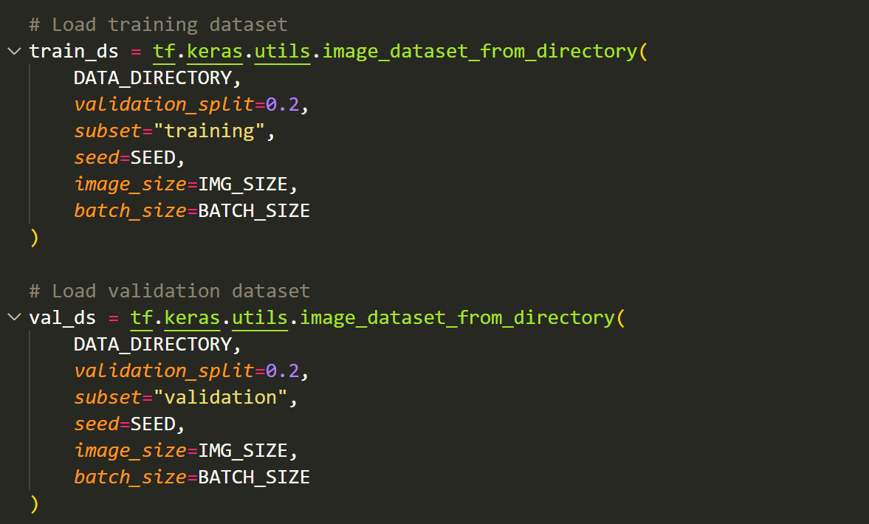

Slide 7
Augmentation
Data augmentation is a technique used to artificially expand the size and diversity of a dataset by applying various transformations to the existing images. Instead of collecting new data, augmentation modifies the current images in different ways such as rotation, flipping, cropping, scaling, brightness adjustment, zooming, and adding noise. These transformations help the model learn to recognize objects (like flowers) even when they appear in different orientations, lighting conditions, or backgrounds.
By increasing the variability of the training data, augmentation helps to prevent overfitting, improve generalization, and enhance the model’s overall accuracy and robustness.
The main purpose of data augmentation is to make the flower classification model more reliable and adaptable, ensuring it performs well on new or unseen images. It allows the model to handle real-world variations effectively and reduces the dependency on a large labeled dataset, ultimately improving the efficiency and performance of the system.

Slide 8
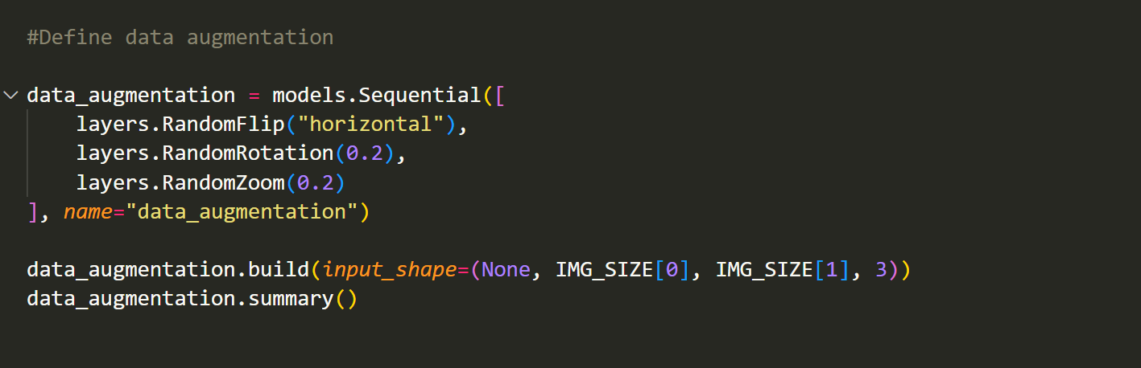

Slide 9
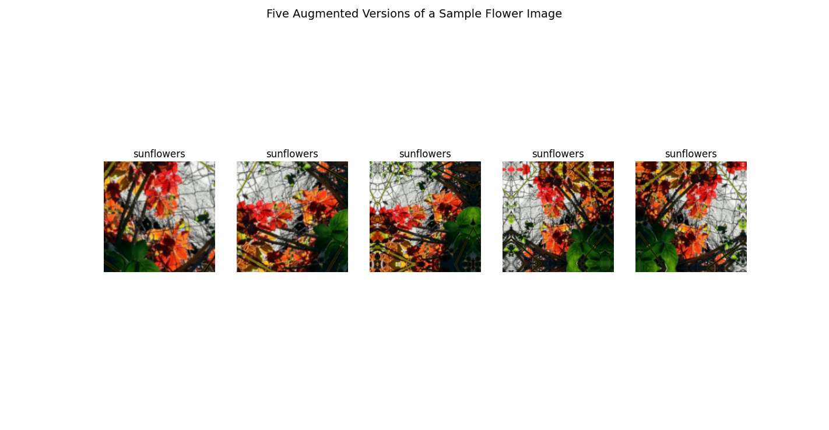
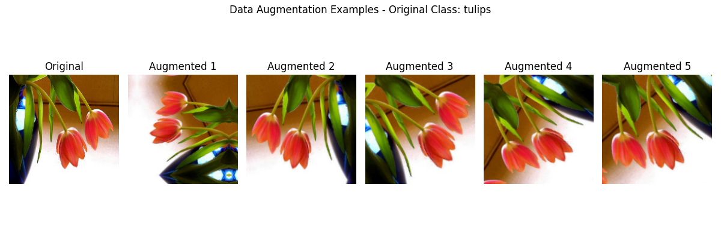
Augmented Outputs of 2 different Classes

Slide 10
Model Development

Slide 11
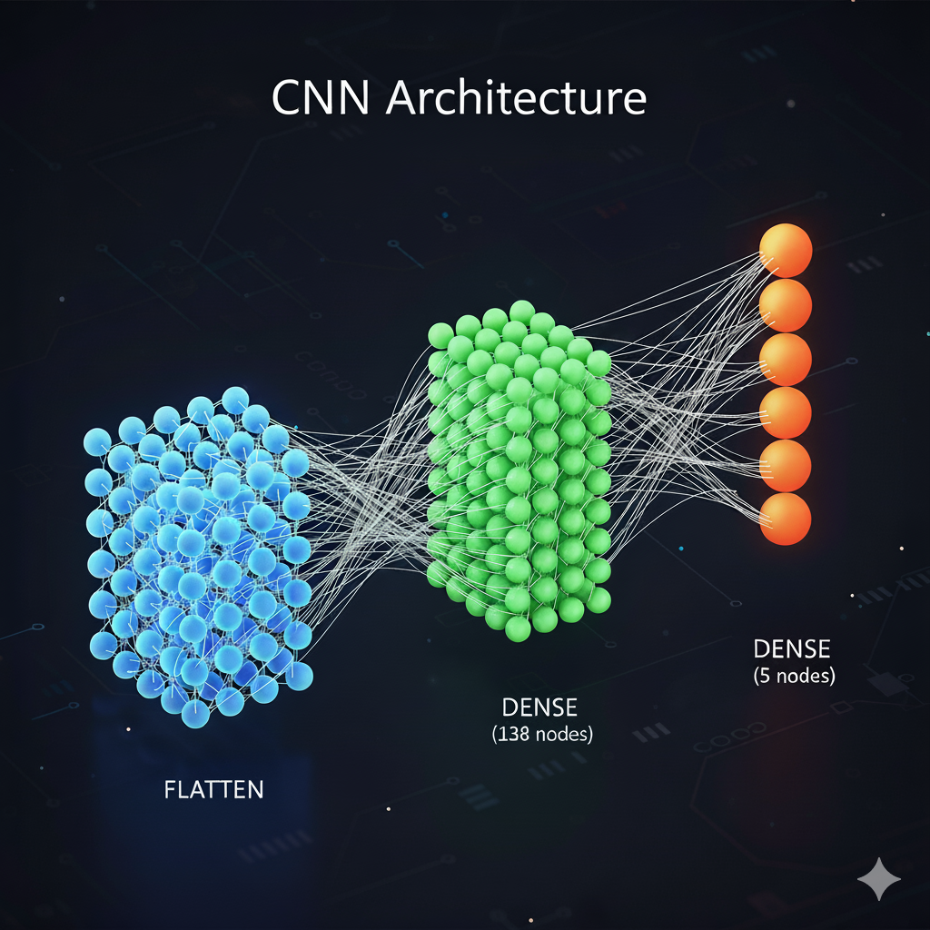

Slide 12
>> What is CNN?
A Convolutional Neural Network (CNN) is a type of deep learning model designed primarily for analyzing visual data, such as images and videos. It works by automatically learning important features from the input images, such as edges, textures, shapes, and patterns, without requiring manual feature extraction. CNNs consist of several layers, including convolutional layers, pooling layers, and fully connected layers.
The convolutional layers apply filters to detect local features, while pooling layers reduce the spatial size of the data to make computation faster and prevent overfitting.
Finally, the fully connected layers use the extracted features to classify the images into categories.
CNN model helps achieve high accuracy and efficiency by automatically learning from the image dataset and making reliable predictions even with complex or varied flower images.

Slide 13
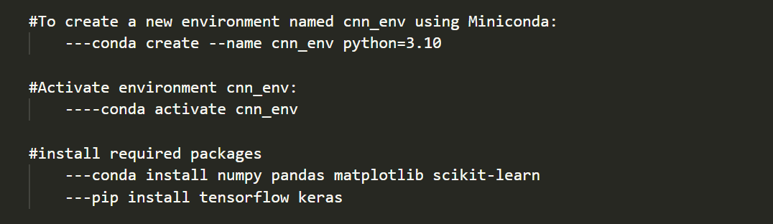
Creating An Environment

Slide 14
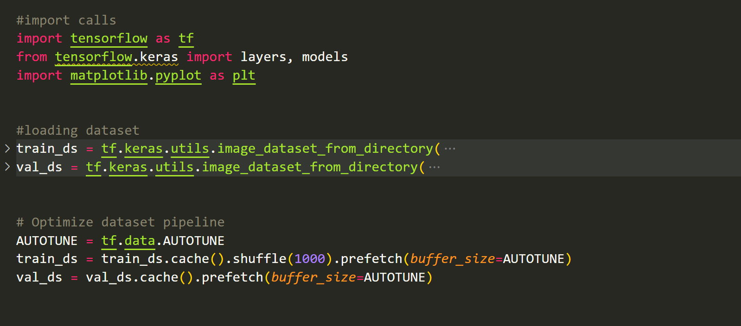

Slide 15
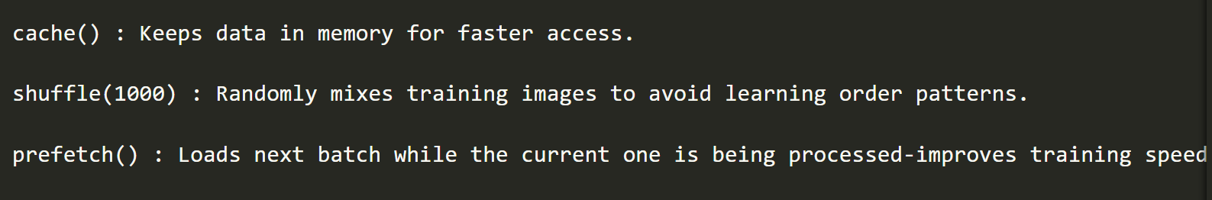

Slide 16
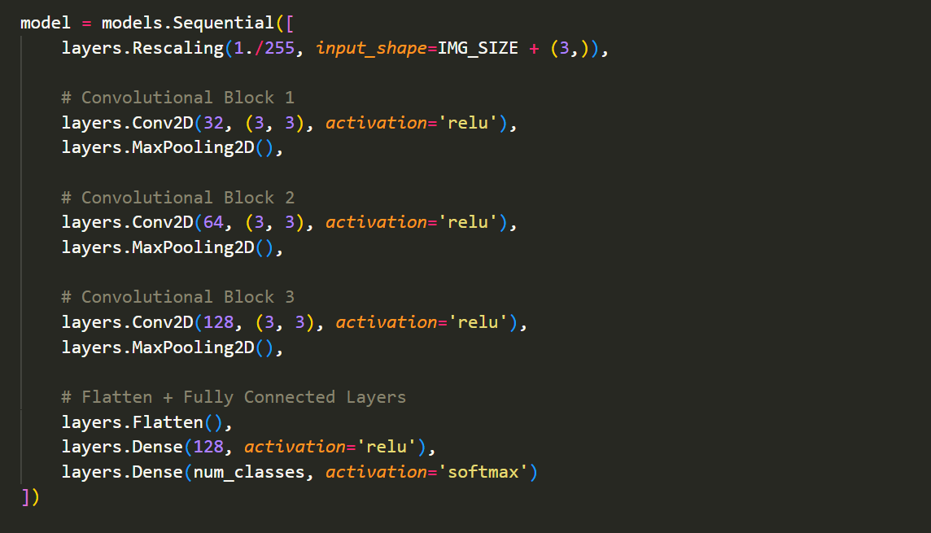

Slide 17
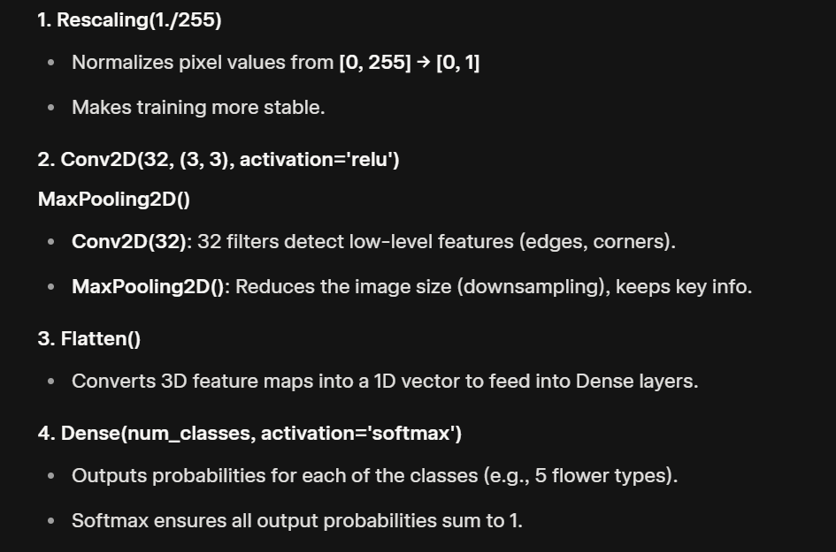

Slide 18
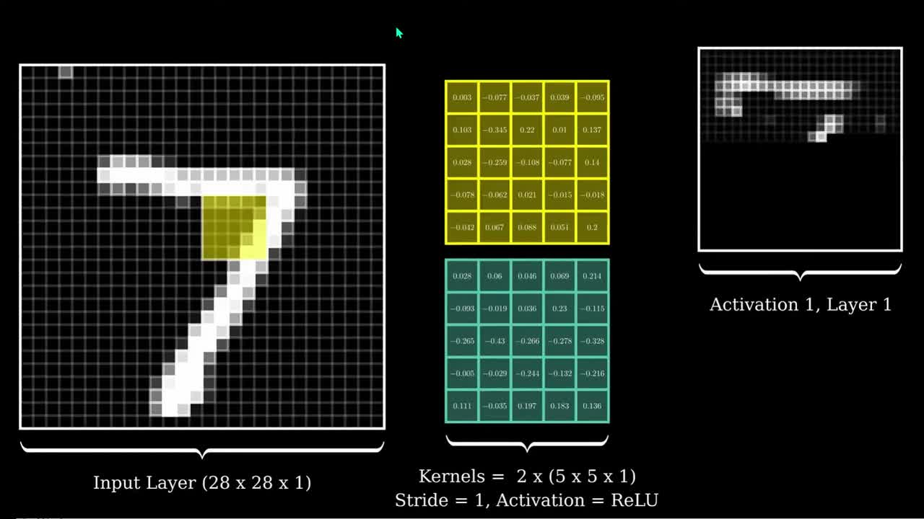

Slide 19
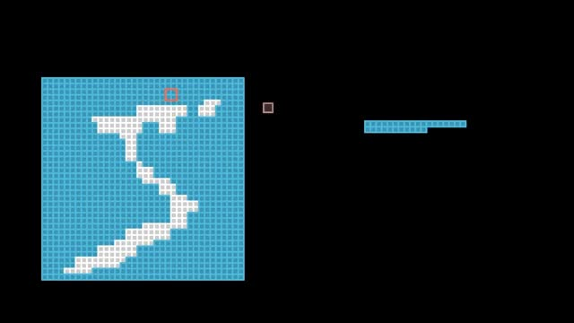

Slide 20
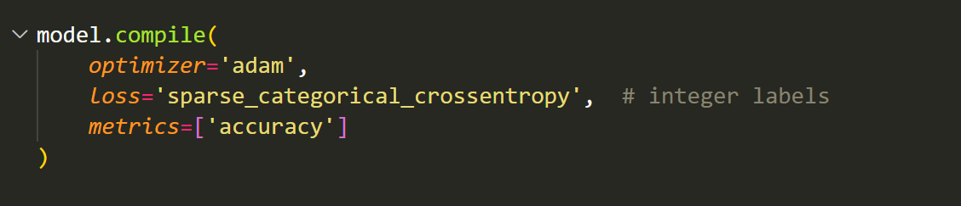
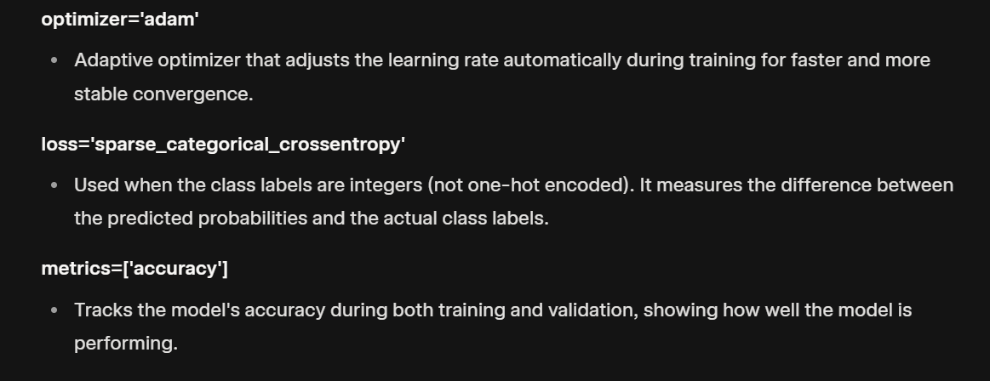

Slide 21
Training And Plotting the Result

Slide 22
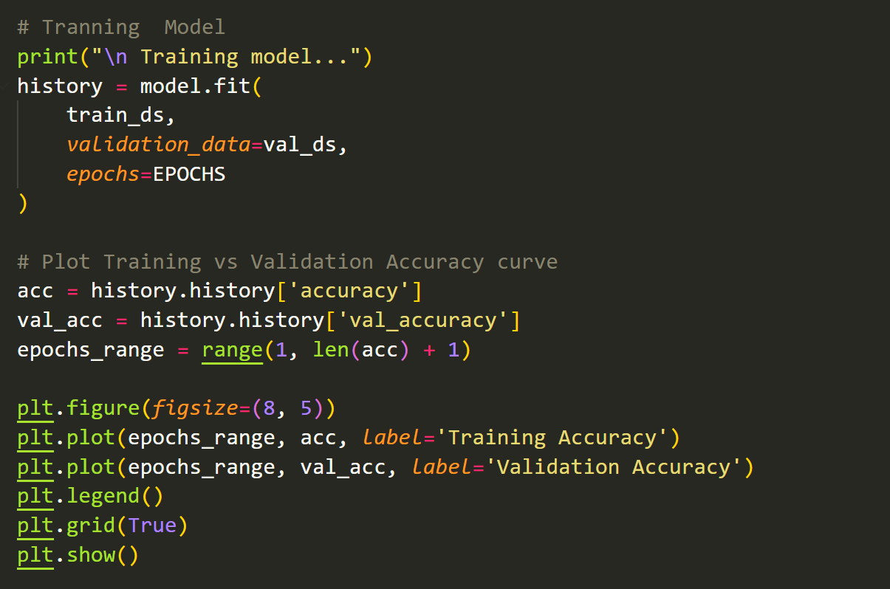

Slide 23
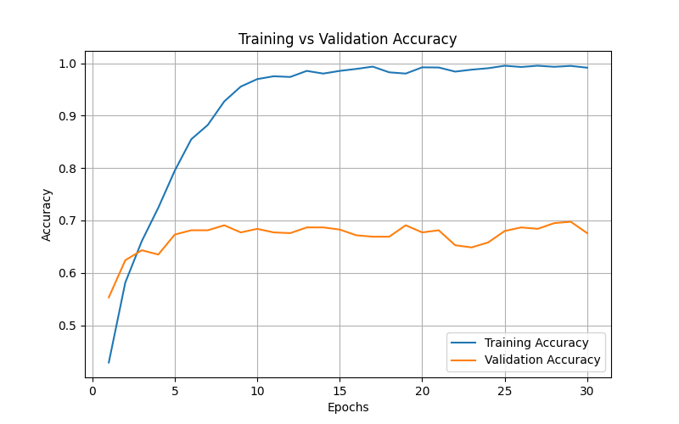
Without Augmentation: Overfitting

Slide 24
Using Augmented the Dataset

Slide 25
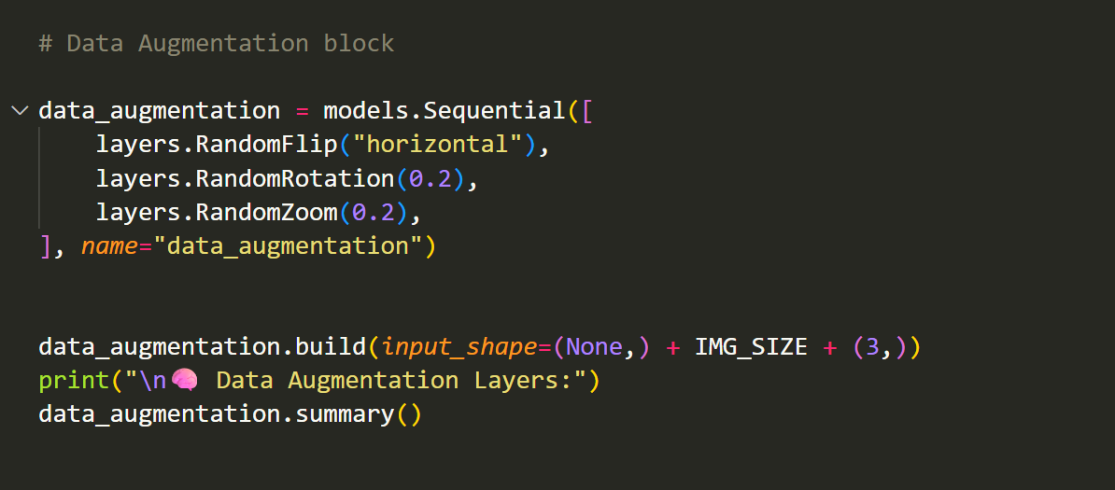

Slide 26
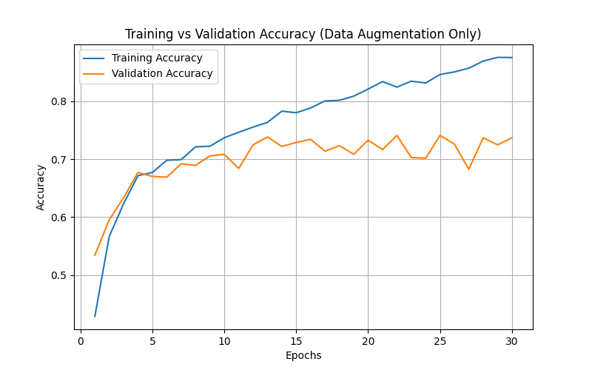

Slide 27
Adding Regularization(L2)

Slide 28
Regularization is a technique used in machine learning to reduce overfitting and improve a model’s ability to generalize on unseen data. Overfitting occurs when a model learns the training data too well, including noise and irrelevant patterns, which reduces its performance on new data. Regularization helps control this by adding a penalty term to the model’s loss function, discouraging it from learning overly complex or large weights.
One common type of regularization is L2 Regularization (also known as Ridge Regularization). In L2 regularization, a small penalty proportional to the square of the weight values is added to the loss function. This means the model slightly reduces large weights during training, ensuring that no single neuron or feature dominates the prediction. As a result, the model becomes more balanced and stable.
The main benefit of L2 regularization is that it helps the model generalize better, prevent overfitting, and improve accuracy on test data. It also ensures smoother learning by keeping the weight values small and distributed evenly across the network.

Slide 29
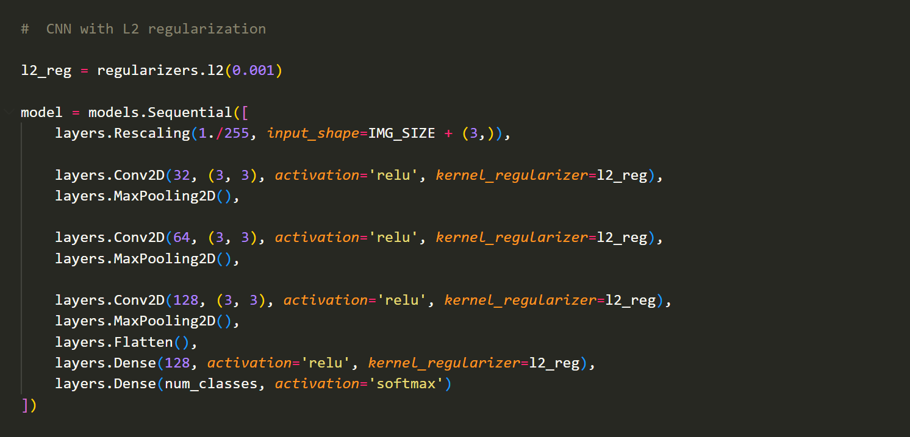

Slide 30
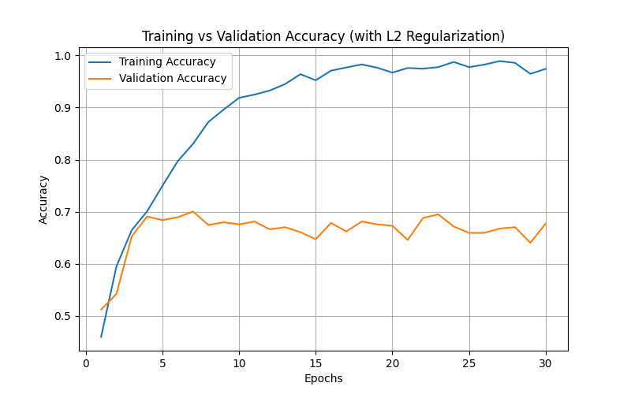

Slide 31
Adding Dropout

Slide 32
Dropout is a regularization technique used in deep learning to prevent overfitting. During training, dropout randomly “turns off” (sets to zero) a certain percentage of neurons in a layer for each iteration. This means that the model cannot rely too much on any single neuron and must learn more robust, general features. By forcing different parts of the network to work independently, dropout improves the model’s generalization, making it perform better on unseen data.
The main benefit of dropout is that it helps create a simpler and more reliable model that does not memorize the training data but instead learns meaningful patterns.

Slide 33
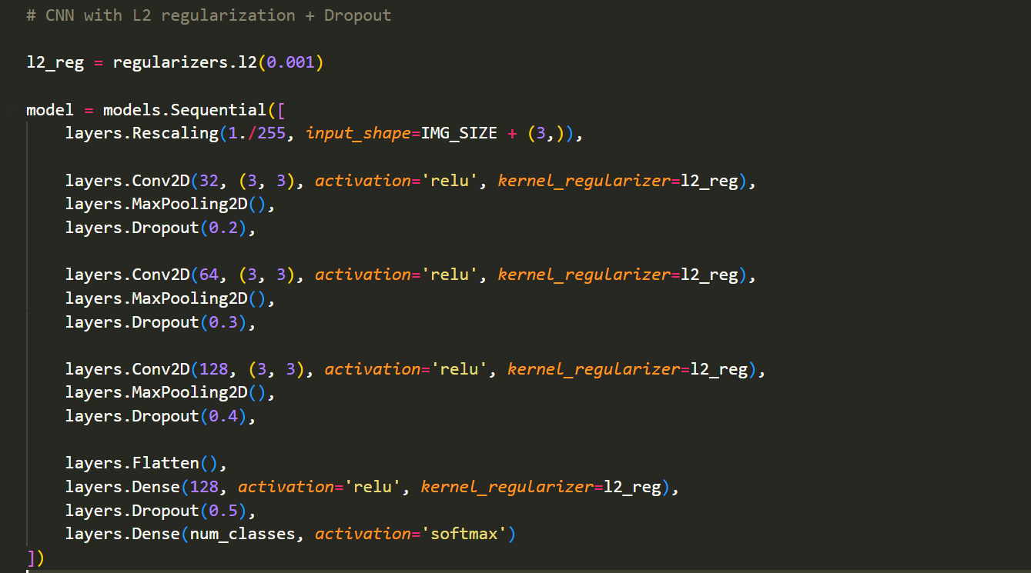

Slide 34
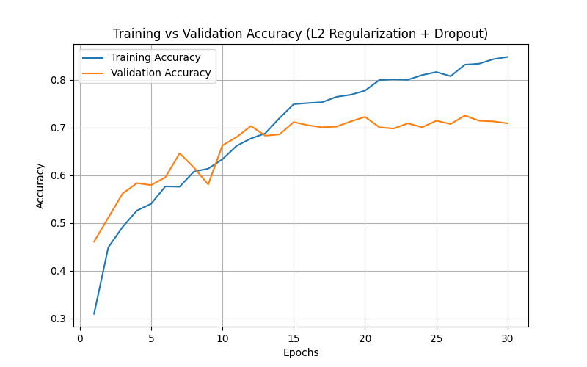

Slide 35
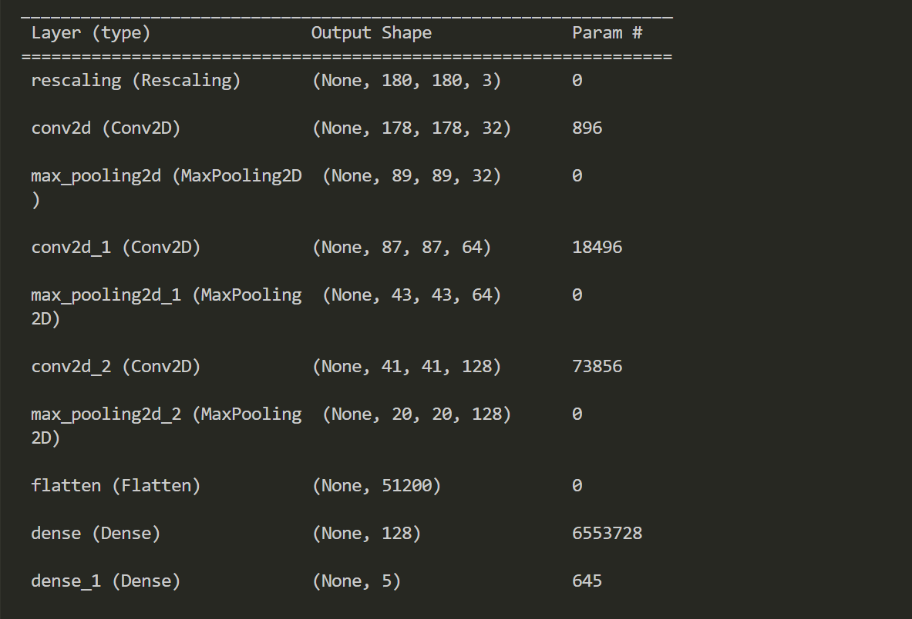
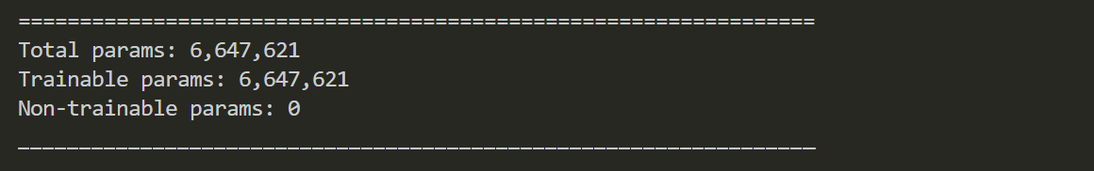

Slide 36
Transfer Learning

Slide 37
Transfer Learning

Slide 38
Transfer Learning
Transfer learning is a machine learning technique where a model developed for one task is reused or fine-tuned for a new but related task. Instead of training a neural network from scratch, transfer learning starts with a pre-trained model that has already learned useful features from a large dataset such as ImageNet. These pre-trained models, like VGG16, ResNet, or MobileNet, already understand general image features such as edges, colors, and shapes. By fine-tuning only the final layers of the pre-trained model, the system can quickly adapt to identify specific classes (like different types of flowers) with high accuracy.
The main benefit of transfer learning is that it reduces training time, requires less data, and often achieves better accuracy compared to training a model from scratch. It makes deep learning more efficient and practical, especially for tasks with limited labeled data.

Slide 39
MobileNetV2 Frozen Based

Slide 40
MobileNetV2 Frozen Base refers to using the MobileNetV2 architecture with its base layers frozen during training. MobileNetV2 is a lightweight neural network that uses special convolution layers to extract important image features quickly and efficiently. When used with a frozen base, the lower layers of MobileNetV2 — which are pre-trained on a large dataset such as ImageNet — are kept unchanged while training on a new dataset. These frozen layers act as a fixed feature extractor, capturing essential image characteristics like edges, colors, and textures. Only the top layers or classifier layers are trained to learn the specific categories of the new dataset, such as different types of flowers in this project. This approach allows the model to utilize the strong feature extraction capability of the pre-trained MobileNetV2 base while adapting the final layers to the new classification task.

Slide 41
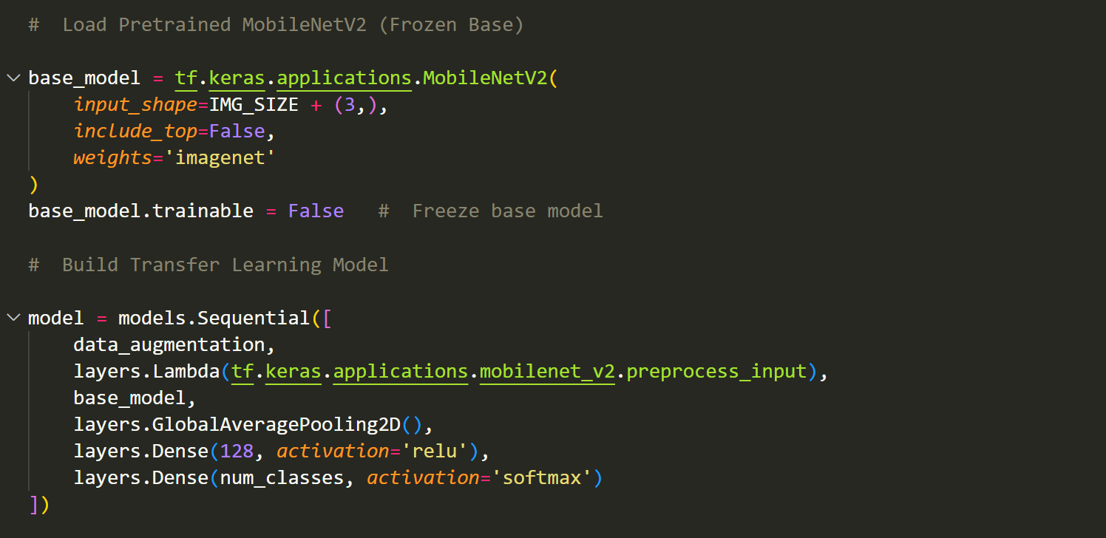

Slide 42
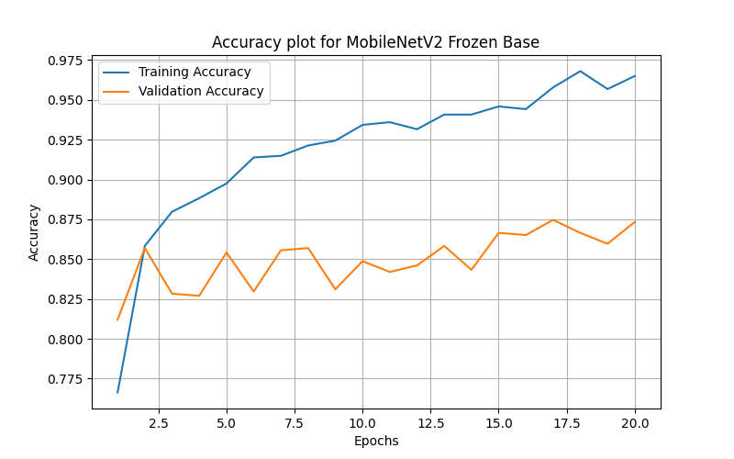

Slide 43
MobileNetV2 : Fine Tunning

Slide 44
Fine-tuning in MobileNetV2 means unfreezing some or all of the layers of the pre-trained model and training them again on a new dataset. Unlike the frozen base approach, here the model’s earlier layers are allowed to update their weights slightly based on the new data. This helps the network adjust its pre-learned features to better match the patterns of the new dataset.
In this process, the model starts with the pre-trained weights from ImageNet and then continues training — usually with a small learning rate — so that it doesn’t forget the useful features it already learned. Essentially, fine-tuning lets MobileNetV2 adapt its feature extraction to the new task, improving how well it understands and classifies the new images.

Slide 45
Unfreeze the last 40 layers and makes them trainable, allowing the CNN to adjust to the dataset while keeping earlier general features intact.

Slide 46
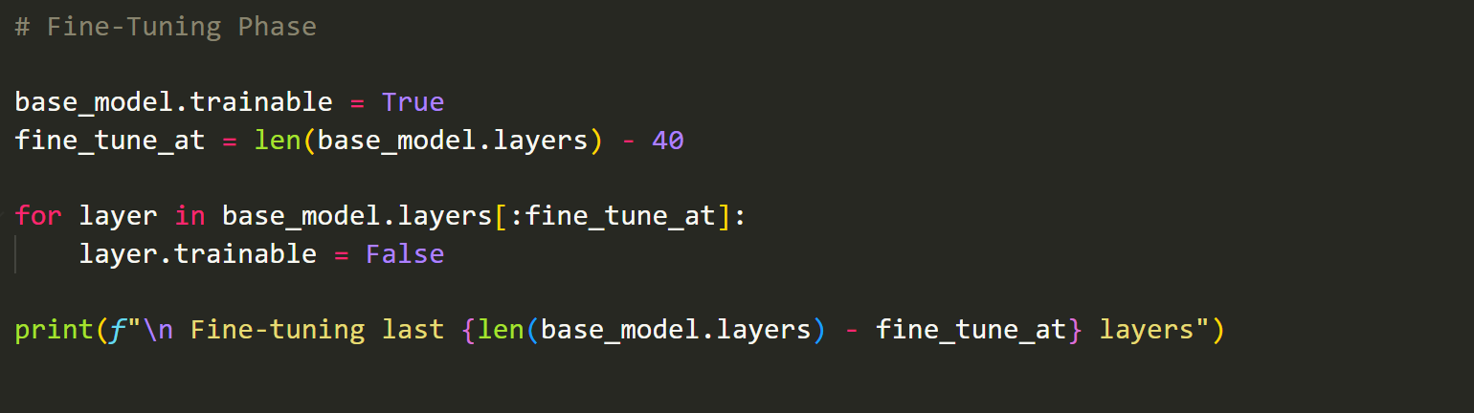

Slide 47
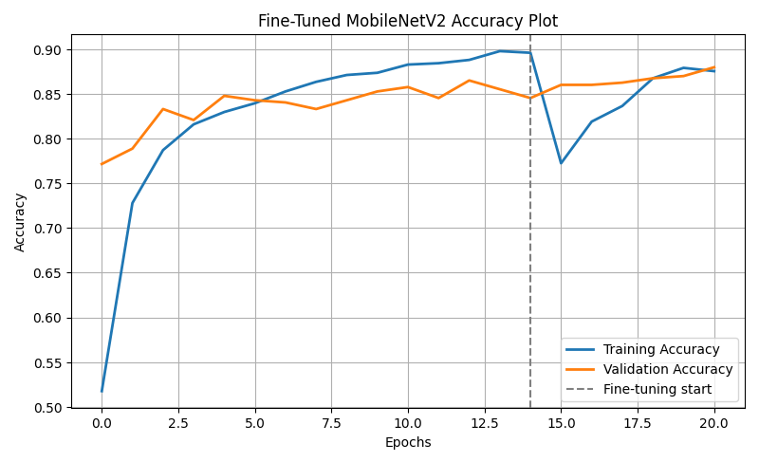

Slide 48
Comparing the models

Slide 49
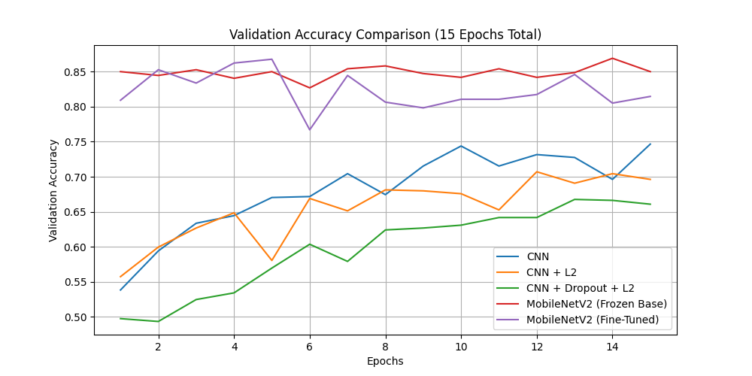

Slide 50
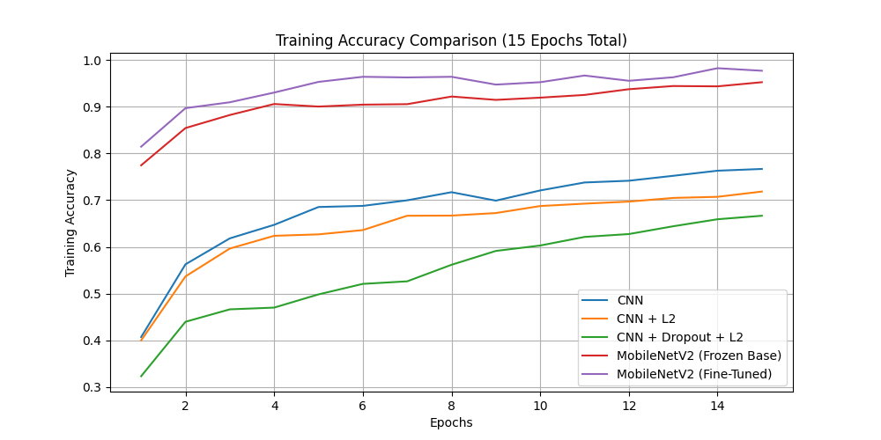

Slide 51
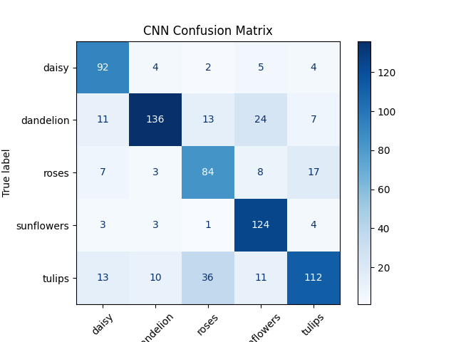

Slide 52
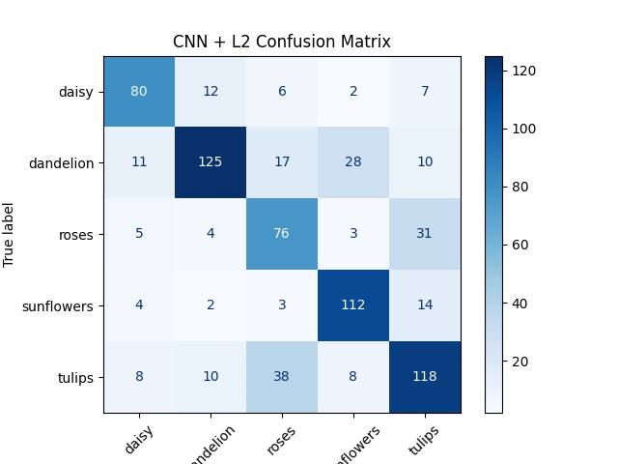

Slide 53
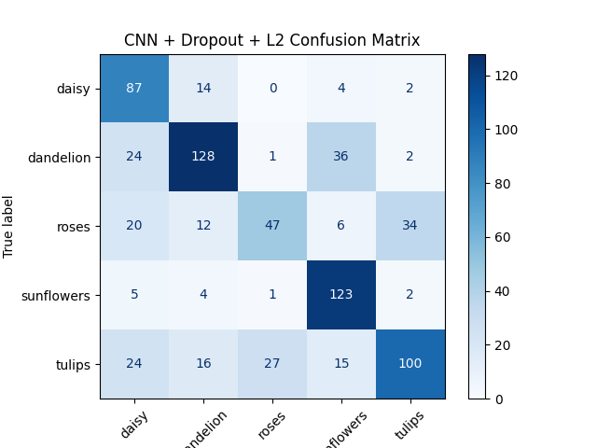

Slide 54
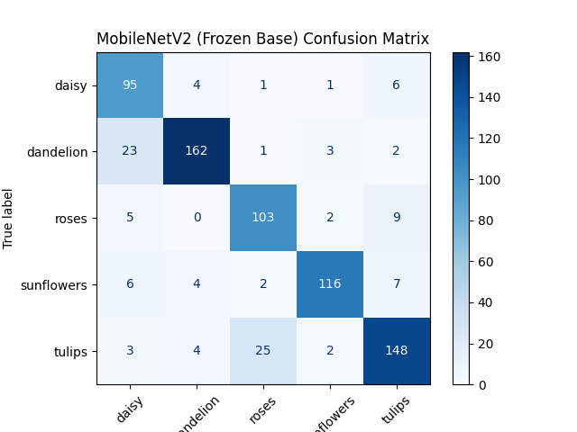

Slide 55
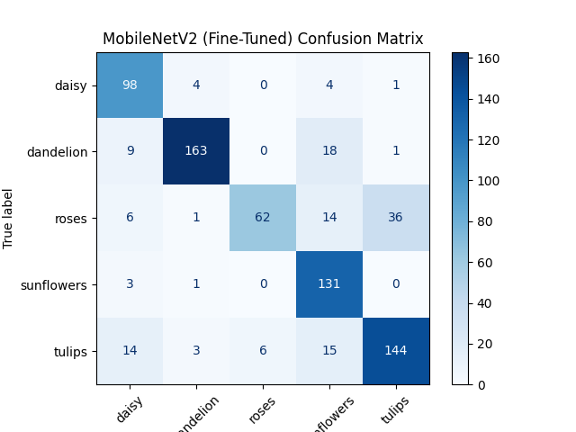

Slide 56
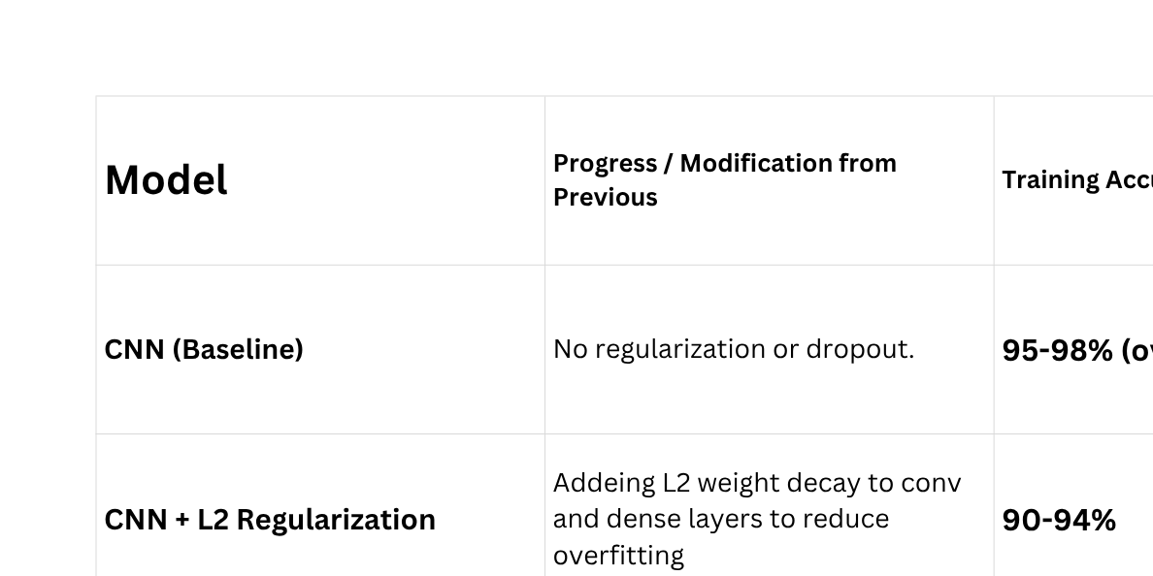

Slide 57
Bonus

Slide 58
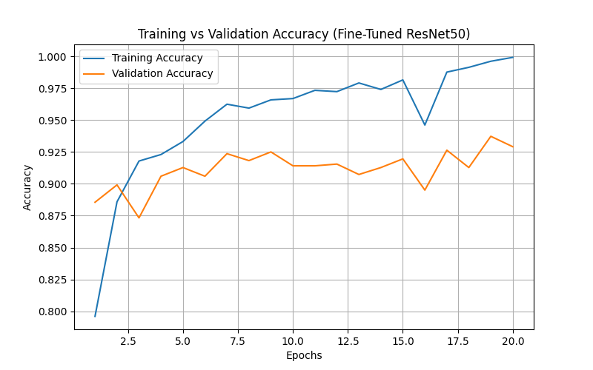

Slide 59
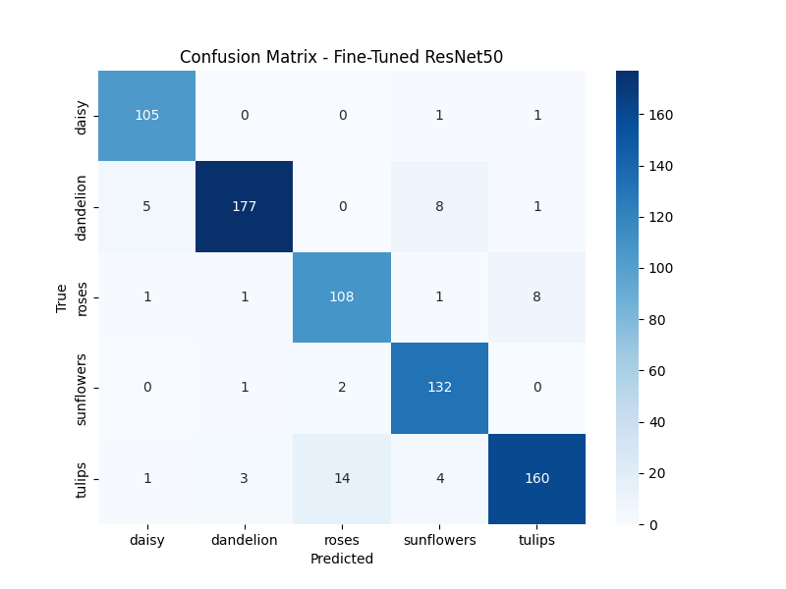

Slide 60
THANK YOU

